Slide 1



SMART TRAFFIC MANAGEMENT SYSTEM Group No. 04 Stage 2: Design & Planning Team Members:
Here is where your presentation begins

Slide 2
Contents of this template
You can delete this slide when you’re done editing the presentation
Fonts | To view this template correctly in PowerPoint, download and install the fonts we used
Used and alternative resources | An assortment of graphic resources that are suitable for use in this presentation
Thanks slide | You must keep it so that proper credits for our design are given
Colors | All the colors used in this presentation
Icons and infographic resources | These can be used in the template, and their size and color can be edited
Editable presentation theme | You can edit the master slides easily. For more info, click here
For more info: Slidesgo | Blog | Faqs
You can visit our sister projects: Freepik | Flaticon | Storyset | Wepik | Videvo

Slide 3


Table of contents
01
02
03
04
05
06
Campaign objectives
Target audience identification
Content
strategy
Content design and creation
Promotion and distribution
Metrics
and analysis

Slide 4
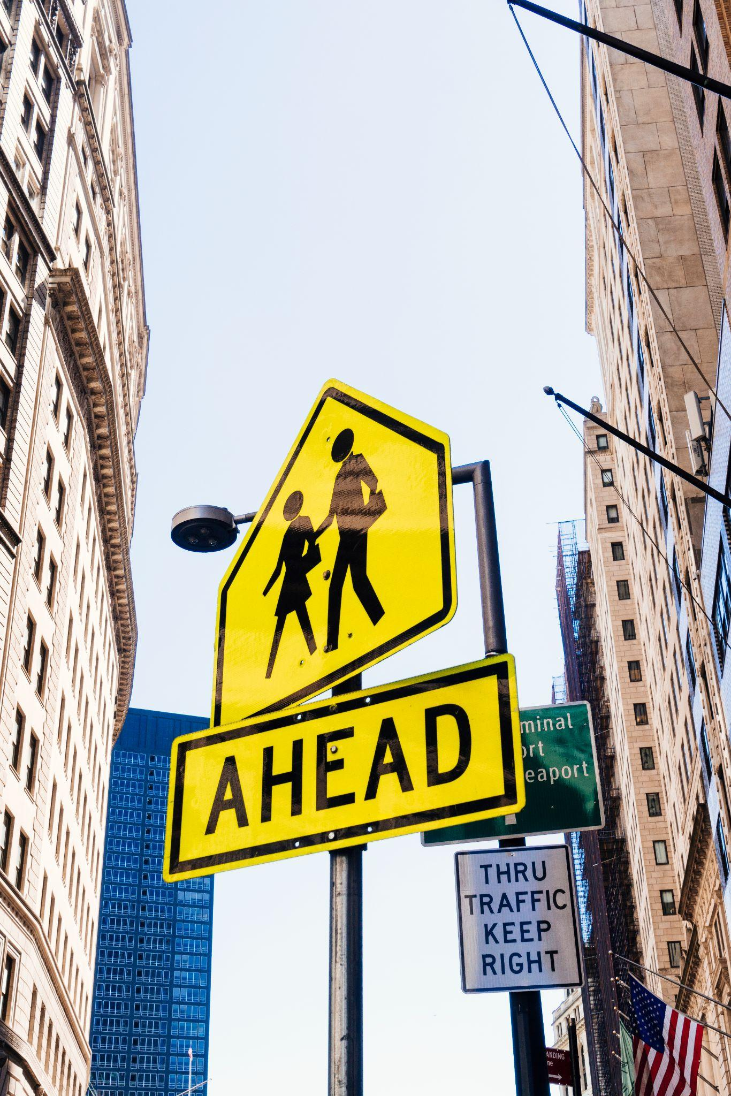
Marketing campaign
Creating a successful marketing campaign requires careful planning and execution. To ensure success, every campaign should include:
Clear objectives aligned with business goals
A deep understanding of the target audience
A comprehensive content strategy that outlines creation, distribution, and promotion
By including these essential components, businesses can create effective, efficient, and impactful campaigns

Slide 5

TOOL JUSTIFICATION SUMO: Accurate and open-source traffic simulation with realistic vehicle generation. Python & TraCI: Enables robust rule-based AI and real-time traffic simulation control. Unity 3D: Provides high-quality 3D graphics for realistic and easy-to-understand visualization. SUMO vs Unity: SUMO handles simulation and data, while Unity provides a better visual representation. Overall Stack: Combines accurate simulation, intelligent processing, real-time control, and realistic visualization.

Slide 6
Campaign objectives
Defining objectives
Business goals
Clear, measurable objectives are crucial for a successful marketing campaign. Start by considering what you want to achieve and define key performance indicators (KPIs) to measure success
Align campaign objectives with business goals by understanding your company's mission, vision, and values. Identify how the campaign can contribute to achieving these goals and adjust objectives accordingly

Slide 7
TASK DISTRIBUTION Content: Clearly define who is doing what.
Member 1 & 2
Member 3
Member 4
Backend LogicPython scriptingTraCI API integrationAI rule creationTraffic signal control logic
Frontend & EnvironmentSUMO Netedit road & lane creationTraffic environment setupUnity 3D visualization
Documentation & CoordinationDesign documentsTesting reportsPresentation creationTeam coordination

Slide 8
RISK PLANNING & MITIGATION
Risk 2 – Unity 3D Lag
Risk 1 – TraCI Communication Failure
Problem: Too many vehicles may cause lag.Mitigation: Use low-poly car models and start with one main intersection.
Problem: Real-time communication may fail.Mitigation: Test basic one-way communication before complex multi-lane logic.
Risk 3 – Task Delay
Problem: A member falling behind may delay the project.Mitigation: Use modular code and test frontend/backend independently with mock data

Slide 9

TEAM COORDINATION & EVIDENCE
Create headlines that grab attention and communicate the value of your content. Use numbers, questions, and power words for your headlines
GitHub Repository
WhatsApp/Discord
Show commit history with member names, uploaded code, and dates.
Show technical discussions and problem-solving.
Visual Evidence
Trello/Google Sheet:
Use screenshots to prove team collaboration.
Show task assignment and completion tracking.
Optimize your content for mobile devices with a responsive design and easy-to-read font sizes. Use high-quality images
Mobile

Slide 10

CONCLUSION & NEXT STEPS
The budget for our next marketing campaign

Slide 11
CONCLUSION & NEXT STEPS
Risks Planned:
Design Complete
Tools Validated
Key technical and team risks have been identified with mitigation strategies.
System architecture and workflow are finalized.
SUMO, Python, TraCI, and Unity 3D are selected and validated.
Backend Development:
Frontend Development:
Next Step
Team is actively working on Python AI logic and TraCI integration. Frontend Development: SUMO environment and Unity 3D visualization are being designed.
Complete integration, testing, and final system implementation.
SUMO environment and Unity 3D visualization are being designed.

Slide 12
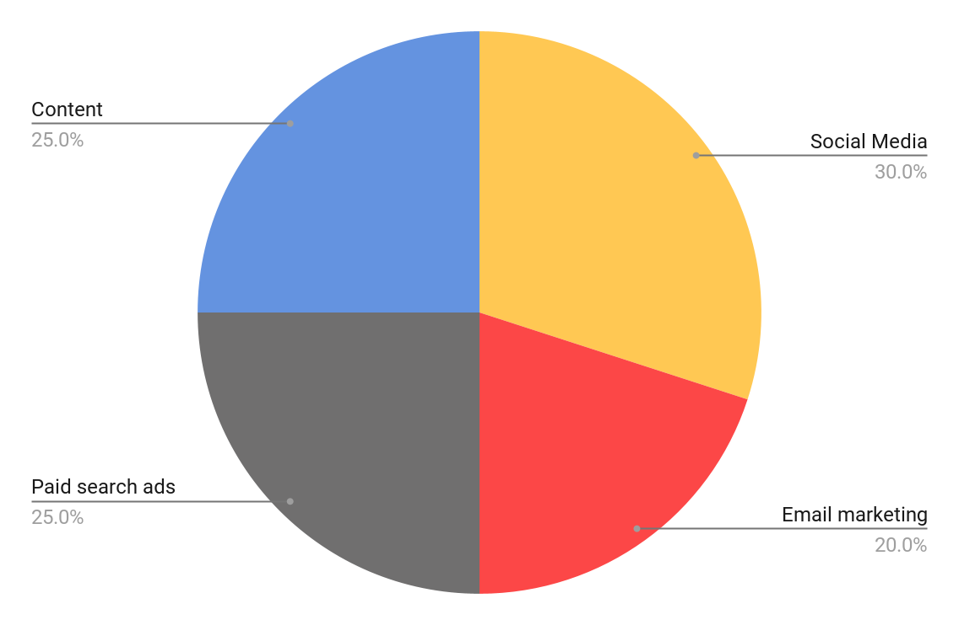
Pie chart
The budget breakdown
Our marketing budget is divided into social media advertising (30%), email marketing (20%), paid search ads (25%), and 25% for content marketing and influencer partnerships. This allocation is based on our previous campaign's effectiveness and targets
Follow the link in the graph to modify its data and then paste the new one here. For more info, click here

Slide 13
Table
Campaign | Impressions | Clicks | Conversions | Conversion rate | Cost per click
Campaign 1 | 50,000 | 2,000 | 100 | 5% | $0.50
Campaign 2 | 75,000 | 1,500 | 90 | 6% | $0.75
Campaign 3 | 100,000 | 3,000 | 120 | 4% | $0.60
Campaign 4 | 60,000 | 1,200 | 60 | 5% | $0.80
Campaign 5 | 80,000 | 2,500 | 110 | 4.5% | $0.70
Total / Average | 365,000 | 10,200 | 480 | 4.83% | $0.67

Slide 14


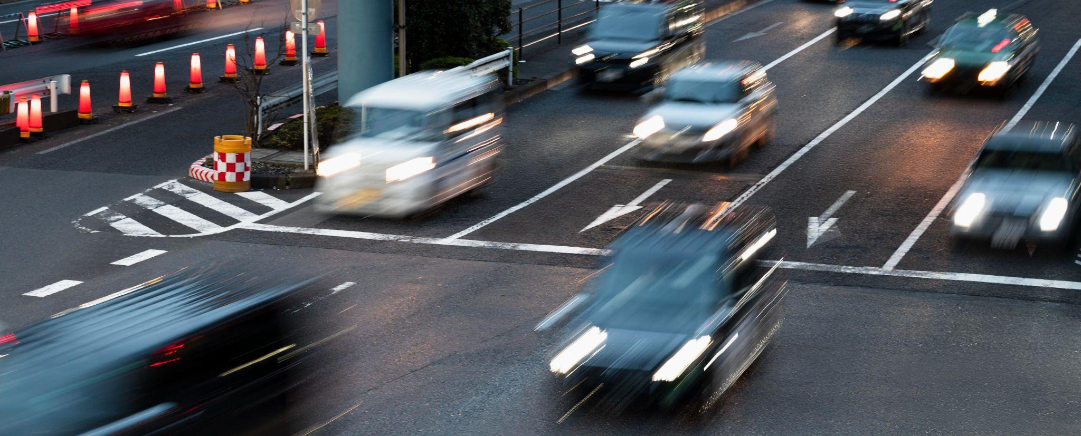
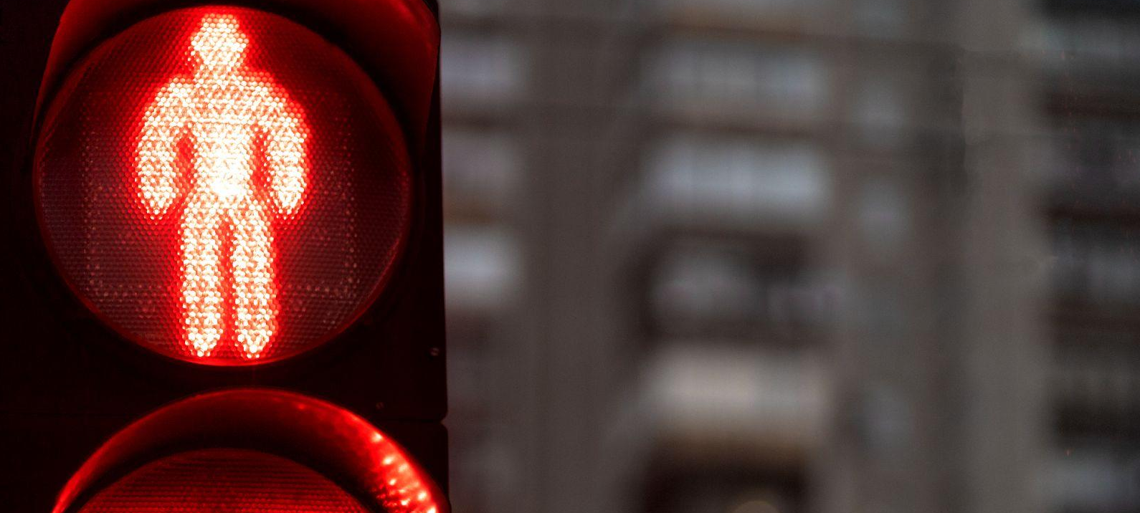
Our product in action
"See how our product helps real people solve real problems. Join the thousands of satisfied customers who have already made the switch to our solution!"

Slide 15

Buyer persona infographic
"I always look for brands that share my values and beliefs"
Motivations
1
Grow my business
2
Achieve financial freedom
Jenna Doe
Personality
32 years old
Marketing manager
Confident and assertive when it comes to decision-making
Creative and always looking for new ideas
Empathetic and able to understand others' perspectives and ideas
3
Find work-life balance
Bio
Pain points
Busy professional who loves the field but also enjoys traveling and spending time with family and friends
Struggles to balance work and personal life due to a busy schedule and overwhelming tasks both at home and work

Slide 16
Roadmap infographic
Initiative | Objective | Jan | Feb | Mar | Apr | May | Jun | Jul | Aug | Sep | Oct | Nov | Dec
Streamline processes | Reduce costs to offer competitive pricing
Enhance communication | Ensure that all teams are aligned on the branding
Innovate products | Highlight product features to attract new customers
Develop talent | Empower employees to take on initiatives
Expand market reach | Expand the company's reach to new markets
Strengthen branding | Increase recognition through brand campaigns

Slide 17
Market size infographic
$100M
$100M
Large companies with significant resources. They highlight cost-saving benefits to establish the brand as leader
$20M
$20M
Mid-sized companies struggling to compete. They showcase unique features and benefits tailored to their needs
$5M
$5M
Small businesses with limited resources. They emphasize affordability and ease of use to attract new customers

Slide 18



Testimonials
"I was skeptical at first, but after using this product, I was blown away by how much time and money it saved me. It's a game-changer!"
—Laura Patterson
"This product has helped us level the playing field and compete more effectively with larger companies”
—John Nelson
"The support team for this product is amazing. They were always available to answer our questions and provide guidance"
—Peter James

Slide 19
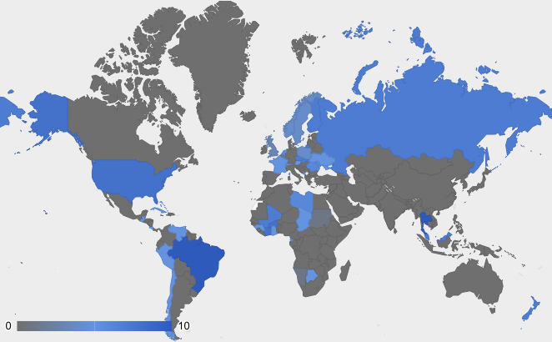
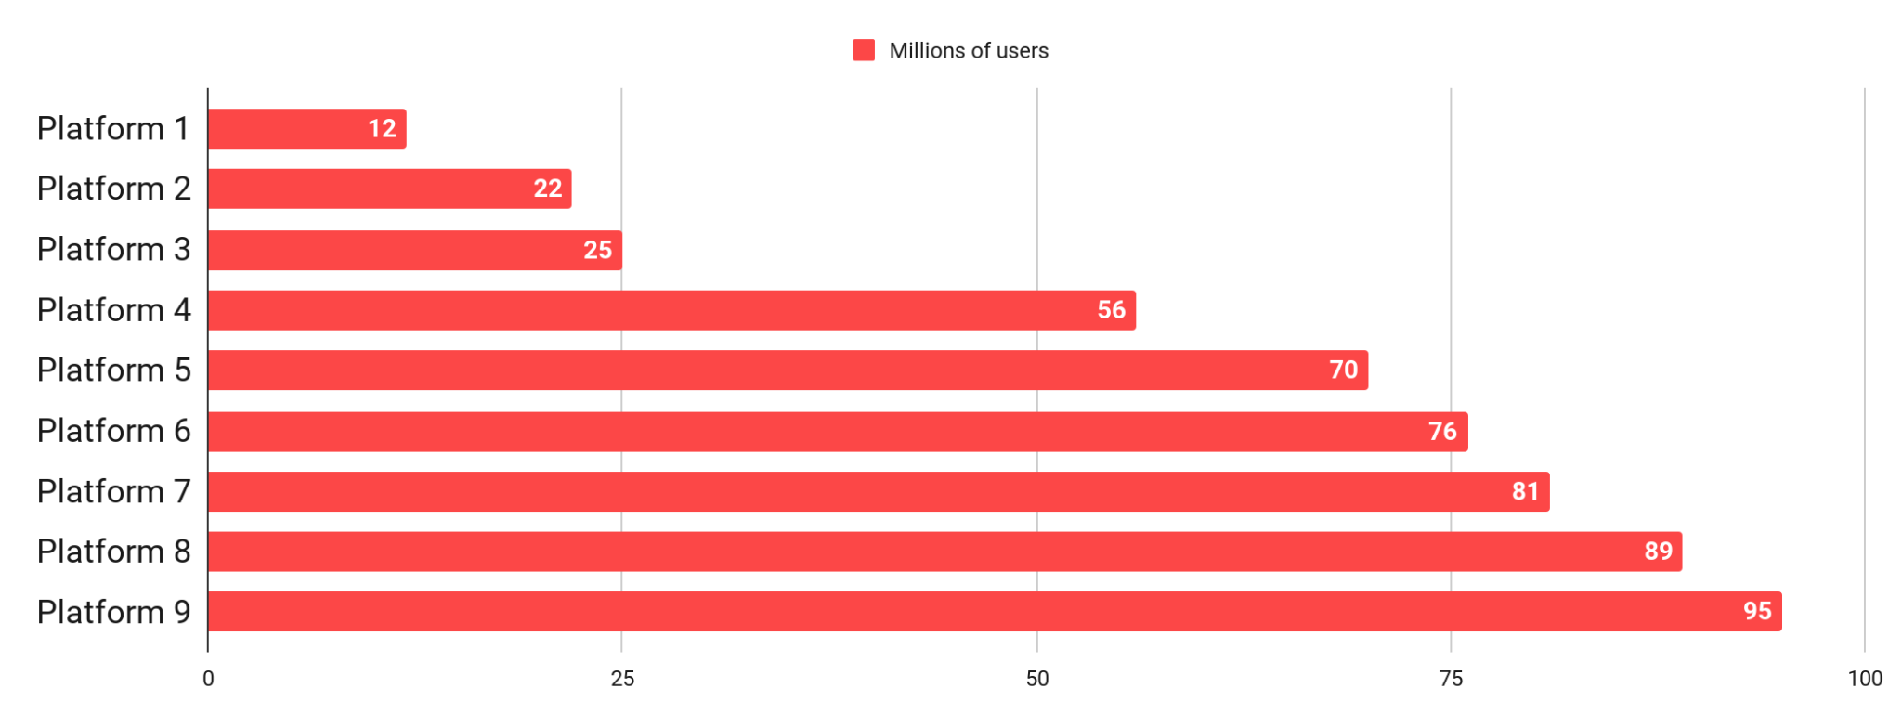
Social media stats
Worldwide reach
Xxx billion
Xh xmin
Xx
Users worldwide
Average
time spent
Number of platforms used
Platforms with most users
Xxx billion
Xxx billion
Country 1 users
Country 2 users
Follow the link in the graph to modify its data and then paste the new one here. For more info, click here

Slide 20
Case studies
Results
Campaign objective
"Highlight the product impact to boost sales"
23%
80%
+10%
Increase in page views
Increase
in sales
Increase
in clicks
Approach
Utilize email marketing campaigns to promote the case study and highlight key product features
Leverage the power of social media to engage with our target audience
Deploy targeted ads to reach potential customers and increase brand visibility
Key takeaway 1
Targeted ads, social media, and email reach customers
Key takeaway 2
Improved profitability through different streamlined operations

Slide 21


Thanks
Do you have any questions?
youremail@freepik.com
+91 620 421 838
yourwebsite.com
Please keep this slide for attribution

Slide 22
Icon pack

Slide 23





Alternative resources
Here’s an assortment of alternative resources whose style fits the one of this template:
Heavy vehicles set
Realistic road and transportation concept with traffic lights signboards under construction and warning signs

Slide 24
Resources
Did you like the resources on this template? Get them for free at our other websites:
Vectors
Push pull sign illustration
Flat under construction sign background
City transport elements set
Traffic signs color transparent set
Traffic sign and lights realistic 3d decorative icons set
Traffic signs and lights pictograms collection
Red road signs realistic set
Banners of cities in different colors
Choose your way
Road map with pointers in flat style
Pack of nine car silhouettes
Icons
Icon Pack: Traffic signs | Flat
Photos
Close-up of handsome man in glasses
Portrait of african american model
Red light sign for pedestrian crossing in the city
Bend to right arrow line sign
Joyful woman with hand in her pockets
Medium shot happy girl posing
Street sign ahead on pillar
People driving cars on the city street
Bicycle warning sign over the modern square pedestrian crossing road sign against blue sky

Slide 25
Instructions for use
If you have a free account, in order to use this template, you must credit Slidesgo by keeping the Thanks slide. Please refer to the next slide to read the instructions for premium users.
As a Free user, you are allowed to:
Modify this template.
Use it for both personal and commercial projects.
You are not allowed to:
Sublicense, sell or rent any of Slidesgo Content (or a modified version of Slidesgo Content).
Distribute Slidesgo Content unless it has been expressly authorized by Slidesgo.
Include Slidesgo Content in an online or offline database or file.
Offer Slidesgo templates (or modified versions of Slidesgo templates) for download.
Acquire the copyright of Slidesgo Content.
For more information about editing slides, please read our FAQs or visit our blog:
https://slidesgo.com/faqs and https://slidesgo.com/slidesgo-school

Slide 26
Instructions for use (premium users)
As a Premium user, you can use this template without attributing Slidesgo or keeping the "Thanks" slide.
You are allowed to:
Modify this template.
Use it for both personal and commercial purposes.
Hide or delete the “Thanks” slide and the mention to Slidesgo in the credits.
Share this template in an editable format with people who are not part of your team.
You are not allowed to:
Sublicense, sell or rent this Slidesgo Template (or a modified version of this Slidesgo Template).
Distribute this Slidesgo Template (or a modified version of this Slidesgo Template) or include it in a database or in any other product or service that offers downloadable images, icons or presentations that may be subject to distribution or resale.
Use any of the elements that are part of this Slidesgo Template in an isolated and separated way from this Template.
Register any of the elements that are part of this template as a trademark or logo, or register it as a work in an intellectual property registry or similar.
For more information about editing slides, please read our FAQs or visit our blog:
https://slidesgo.com/faqs and https://slidesgo.com/slidesgo-school

Slide 27
Fonts & colors used
This presentation has been made using the following fonts:
Lexend
(https://fonts.google.com/specimen/Lexend)
DM Sans
(https://fonts.google.com/specimen/DM+Sans)
#191919
#6493e0
#ededed
#ddd9d9
#aaa6a6
#706f6f
#ffc853
#fc4747
#2e5abc
#ffffff

Slide 28





Storyset
Create your Story with our illustrated concepts. Choose the style you like the most, edit its colors, pick the background and layers you want to show and bring them to life with the animator panel! It will boost your presentation. Check out how it works.
Pana
Amico
Bro
Rafiki
Cuate

Slide 29
Use our editable graphic resources...
You can easily resize these resources without losing quality. To change the color, just ungroup the resource and click on the object you want to change. Then, click on the paint bucket and select the color you want. Group the resource again when you’re done. You can also look for more infographics on Slidesgo.

Slide 32
JANUARY
FEBRUARY
MARCH
APRIL
MAY
JUNE
PHASE 1
Task 1
Task 2
PHASE 2
Task 1
Task 2
JANUARY
FEBRUARY
MARCH
APRIL
PHASE 1
Task 1
Task 2

Slide 35
...and our sets of editable icons
You can resize these icons without losing quality.
You can change the stroke and fill color; just select the icon and click on the paint bucket/pen.
In Google Slides, you can also use Flaticon’s extension, allowing you to customize and add even more icons.

Slide 36
Educational Icons
Medical Icons

Slide 39
Creative Process Icons
Performing Arts Icons

Slide 40
Nature Icons

Slide 41
SEO & Marketing Icons

Slide 42


